Slide 1

The history of UI architecture design approaches. From code-behind to MVVM. Part 1: INTRO. Back in the days. CODE-BEHIND.
by: Fedor Reznik

Slide 2
Intro
About me. 20+ years of .Net. JB & DB.
The purpose: summarizing the experience. Highly opinionated.
Historically incorrect: MVC pattern older than .Net.
The code & domain: very simple.
The place for discussion: LinkedIn.
All links in description.

Slide 3
domain and First user story
Domain:
Cat feeders' business.
New opportunity - Bluetooth. ICatFeederDriver.
The aim: a desktop app.
First user story: implement MVP.

Slide 4
Back in the days. Code-behind.
ASSUMPTIONS:
Expertise in WinForms.
Code-behind is “easy & quick”.
LET’S CODE!

Slide 5
Back in the days. Code-behind.
ISSUES:
Testing phase: QA has spotted a bug.
After release: missed memory leak.
DISASTER! LET’S FIX IT!

Slide 6
Back in the days. Code-behind.
OUTCOME:
Mix of UI and functional related code.
No tests. QA – rules. Regression testing boredom.
Separation of duties: “UI-guru” vs “Tech-guru”.
Not only IDisposable. “Operation” ownership.
Work in parallel. The nightmare of merge conflicts.
FORMALIZING => NFRS!

Slide 7
Not only user stories.
DEFINITION: a non-functional requirement (NFR) is a requirement that specifies criteria that can be used to judge the operation of a system, rather than specific behaviours. They are contrasted with functional requirements that define specific behavior or functions.
Subset for assessment:
Testability – logical, component, e2e, etc. Magneto automation story.
Extensibility – new features, customizations.
Adaptability – technology change. Taxi-driver story.
Effectiveness – development speed. How many team members?
Reusability – ☺. Components. Coupling & Cohesion.
Readability - ☺.

Slide 8
Back in the days. Code-behind (CB). Assessment
NFR | CB | COMMENT
Testability | ☹☹ | UI Automation
Extensibility | ☹☹ | New forms possible.
Adaptability | ☹☹☹ | UI is mixed with logic
Effectiveness | ☹ | With merge conflicts pain
Reusability | ☹ | UserControls refactoring
Readability | ☹☹ | 30 KLOC story.
Legend: ☹ - low, 😐 - moderate, ☺ - high
* More than one increase trait

Slide 9
Back in the days. Code-behind.
THE BLASPHEMY: it might work!
SRP Forms. CRUDs.
Multiple-windows.
Confirmation dialogs.

Slide 10
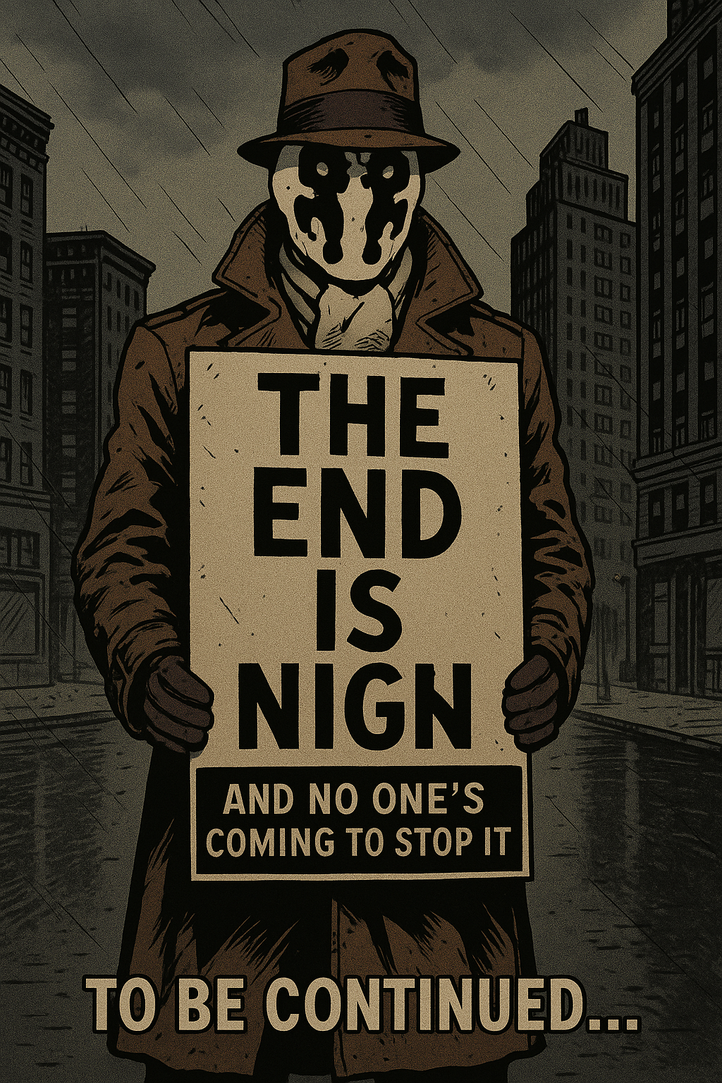
Back in the days. Code-behind. Decline

